Slide 1
CS674: Robot Learning Simultaneous Localization and Grasping
Based on the Work :-
Robert Platt, Leslie Kaelbling, Tomas Lozano-Perez, and Russ Tedrake. Simultaneous Localization and Grasping as a Belief Space Control Problem

Slide 2
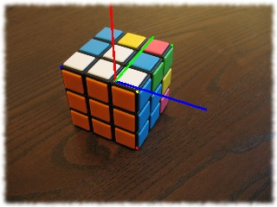
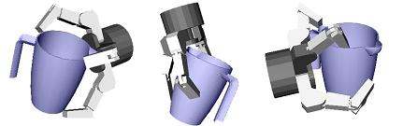
Grasping Problem
What does it depend upon ?
Pose Estimation : getting a 6D pose of the object.
Planning to reach a good grasping position.

Slide 3
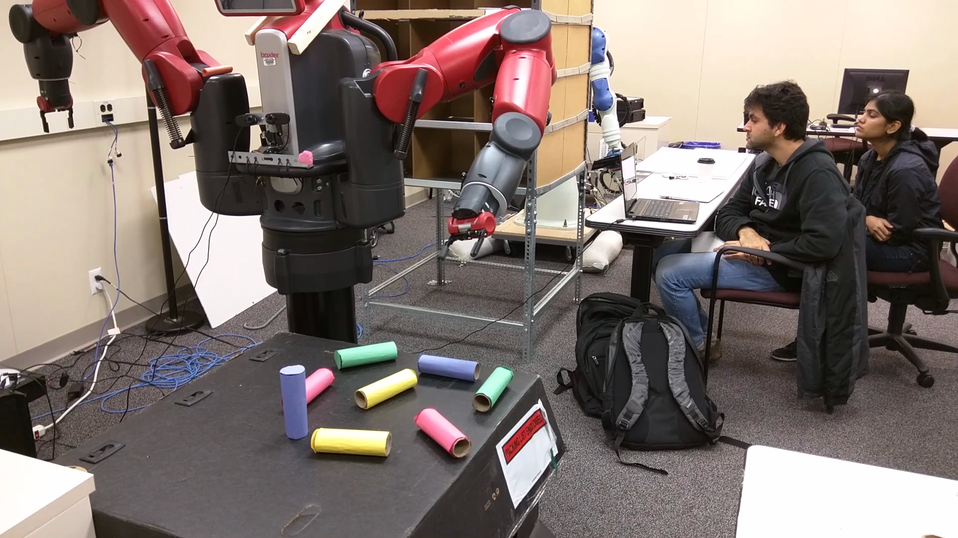
What Could go Wrong ?

Slide 4
SLAG-SLAM
Thus, this paper simultaneously tries to solve the problem of localizing the object and reaching grasp configuration.
The terminology is motivated from the popular class of problem SLAM(Simultaneous localization and mapping). Here, we try to estimate the position of an agent while simultaneously updating the map of the environment.(Application : Indoor Localization; techniques : Particle filter, extended Kalman filters)

Slide 5
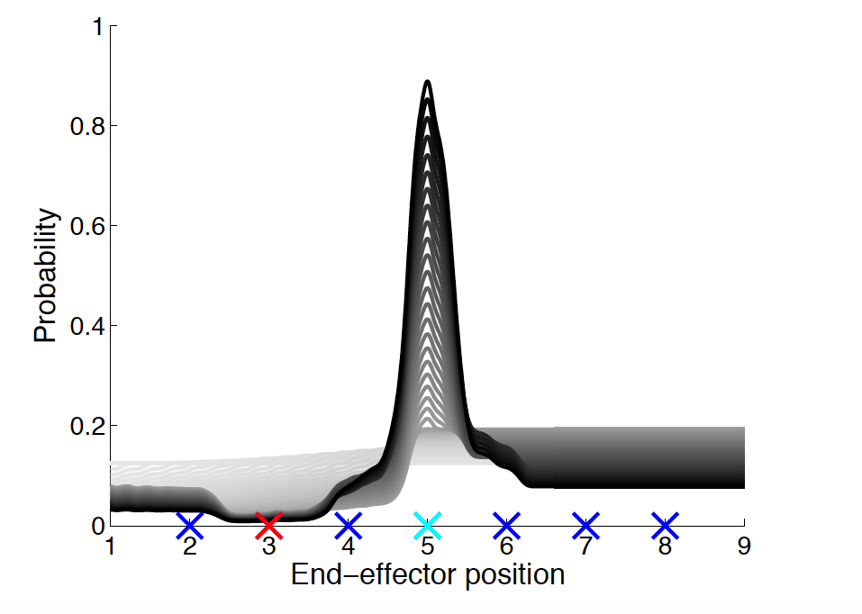
Belief State
Method supports non-Gaussian belief states
we track a probability density function, π(x ;b) , over grasp state

Slide 6
Updating Belief State
It is possible to track belief state over time as a function of actions and observations using Bayes filtering
π( f (x, u_{t} );b_{t}+1) = π(x; b_{t})P(z_{t+1}|x,u_{t} )
P(z_{t}+1)

Slide 7

Objective
Starting from π(x ;b₁) , the SLAG problem is to reach a configuration where the posterior distribution, p(x ;b_{T}) , is very peaked about he grasp configurations, G.
take a sequence of actions, u1, . . . ,u_{T−1} , such that,
Given,
process and observation dynamics, f and h
desired set of grasp configurations G
desired probability of grasp success, ω

Slide 8
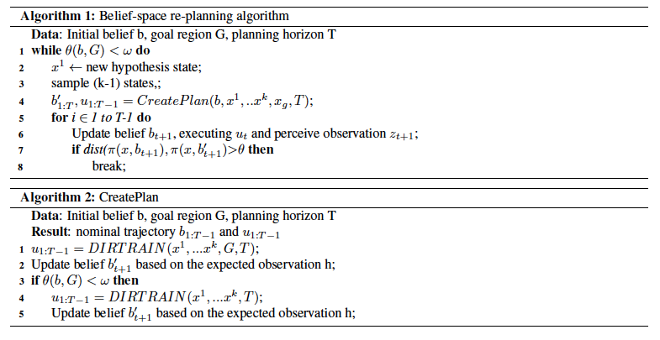
Algorithm

Slide 9
Algorithm
The re-planning algorithm runs until the belief of being in goal grasping configuration exceeds a threshold.
Hypothesis and the sample states are re-generated and CreatePlan method is invoked to compute a path to reach goal configuration while minimizing the probability around sampled states.
In the function CreatePlan, in case a plan does not exist to reach the goal state with high probability in step 1, we try to compute a plan without the goal configuration but with the objective to localize.
The belief state returned by CreatePlan is generated by the computing the expected observation following the trajectory given by the plan, starting from the initial belief.
In line 7 of the re-planning algorithm we compare the above belief state with the actual belief state generated by using the measurement updates in each time step.

Slide 10
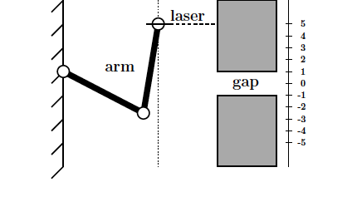
Example 1
Use a horizontal-pointing laser mounted to the end-effector of a two link robot arm.
The objective was to localize the position of the end effector and to reach a goal state corresponding to a gap between two vertically mounted boxes

Slide 11
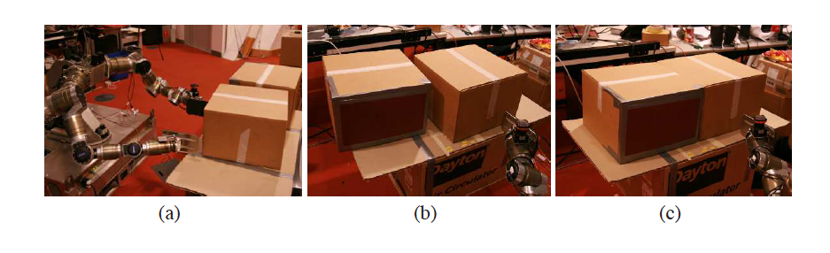
Example 2
In the second setting, a multi arm robot is used to localize the pose and dimension of boxes using laser scanner and also be able to grasp the boxes.

Slide 12
Thank You

